Slide 1
Design Patterns
Presented By:
Fernando Zamora
Twitter: @fernandozamoraj
Blog: fernandozamorajimenez.blogspot.com
Github: https://github.com/fernandozamoraj

Slide 2
About Me
Fernando Zamora
Developer
Aspiring Craftsman
Work: Technical Lead MAT, Government Contract Winforms C#
Hobbies: Write code outside of work that I don’t get to write at work
Games: XNA, Windows Phone, Android
Web: HTML5, PHP, Asp.net, Javascript

Slide 3
Objectives of This Presentation
Introduce the Topic of Design Patterns
What design patterns are
List all the original 23 Gang of Four Design Patterns
Introduce the necessary UML required for understanding DP
Introduce 4 to 5 design patterns in Detail
Inspire you to research design patterns further
Gather Interest on a part 2 of design patterns

Slide 4
Philosophy and Beginnings
We are talking about software. Right?
Reusable solution to a commonly occurring problem within a given context
Christopher Alexander (1977/79)
A Pattern Language: Towns, Buildings, Construction
4. Form a common language
5. GoF – DESIGN PATTERNS Elements of Reusable Object Oriented Software Gamma, et al. (1995)

Slide 5
Design Pattern Categories
23 Patterns in GoF- Foundation
3 Groups
Creational
Structural
Behavioral
Specific Areas such as architecture, UI, concurrency, security
4. Forces and Solution
5. UML

Slide 6
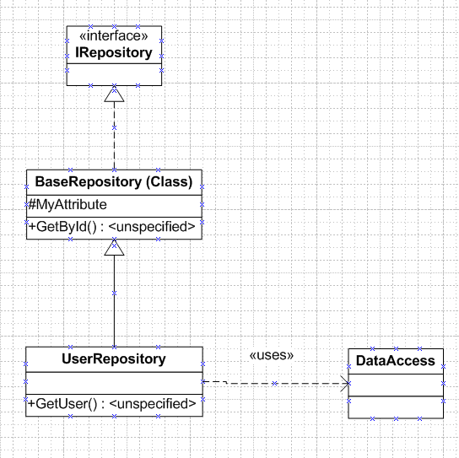
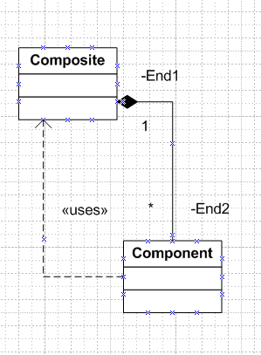
UML Symbols
.

Slide 7
Structural Patterns
Decorator – Add or remove functionality at run time
Proxy – Control Access to an Object
Bridge – Enable development of the interface and implementation of a component to proceed independently. Switch runtime implementations.
Composite – Treat single objects and composites in same way
Flyweight – Reduce cost of working with large number of very small objects
Adapter – Match otherwise incompatible interfaces
Facade – Reorganize a system with many subsystems into identifiable layers of single entry points
Simplify Interface to a complex subsystem

Slide 8
Creational Patterns
Prototype – Creates new objects by cloning of a few stored prototypes
Factory Method – Method decides which concrete implementation
Singleton – One instance of a class with global access

Slide 9
Behavioral Patterns
Strategy – Client chooses concrete implementation
State – Context changes from state to state
Template Method – Template algorithm with certain steps to be handled elsewhere
Chain of Responsibility – List of handler objects and handling stops at first successful handling
Iterator – foreach case closed
Mediator – enables communications of objects without those objects knowing each other

Slide 10
Behavioral Patterns
Observer – Publisher Subscriber System
Visitor – Defines and performs new operations on all elements of an existing structure
Interpreter – ?
Memento – Captures the state of an object’s internal state and saves externally

Slide 11
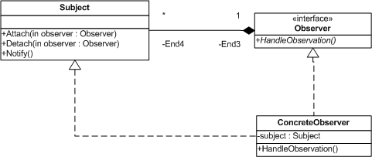
Observer Pattern
Publisher/Subscriber
Notifier/Handler

Slide 12
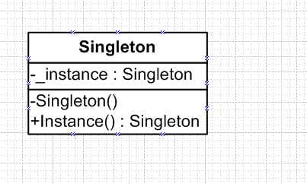
Singleton Pattern
Single Instance across the application

Slide 13
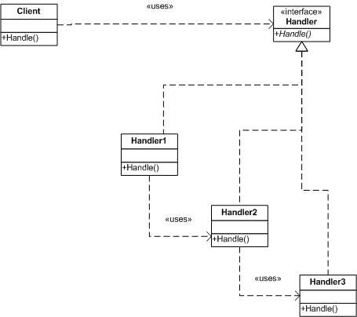
Chain of Responsibility
List of handlers set in sequence of priority
Extensible

Slide 14
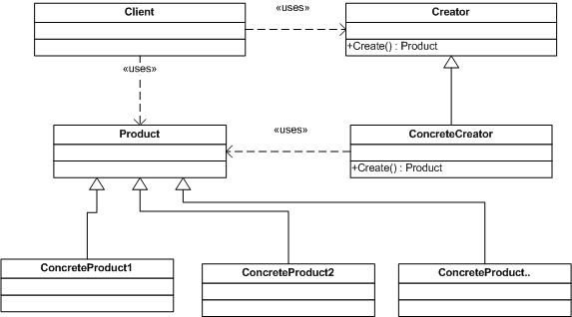
Factory Method
Group – Creational
Role - Implement the concept of factories

Slide 15
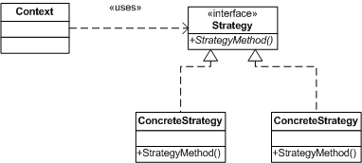
Strategy
Group: Behavioral
Extract Strategy out of context to simply client and maintain cohesion

Slide 16
About Fernando Zamora
Sr. Software Engineer @ McLane Advanced Technologies
Personal Blog, Etc: http://fernandozamorajimenez.blogspot.com/
Email: fernando.zamora.jimenez@gmail.com
Twitter: @fernandozamoraj
Copyright 2008 McLane Advanced Technologies, LLC

